Slide 1
Effortless Distributed Computing in Python
FOSDEM – Feb. 2025
Raphael J.
https://raphaelj.be

Slide 2
Menu
Three new Python libraries for distributed computing ! 🎉
Scaler
A light-weight and resilient distributed scheduler
Parfun
A hassle-free map-reduce decorator
Pargraph
A declarative distributed graph engine

Slide 3
Scaler
Scaler
A light-weight and resilient distributed scheduler

Slide 4
Scaler
A distributed replacement for Python’s built-in concurrent.futures parallel executors
Computes these functions in other processes, same computer
from concurrent.futures import Future, ProcessPoolExecutor
with ProcessPoolExecutor(max_workers=4) as executor:
a: Future[float] = executor.submit(math.sqrt, 9)
b: Future[float] = executor.submit(math.sqrt, 16)
print(a.result() + b.result()) # prints "7.0”
Blocks until the result is available

Slide 5
Scaler
A distributed replacement for Python’s built-in concurrent.futures parallel executors
Computes these functions on a remote cluster
from scaler import Client, Future
with Client(cluster_URL) as executor:
a: Future[float] = executor.submit(math.sqrt, 9)
b: Future[float] = executor.submit(math.sqrt, 16)
print(a.result() + b.result()) # prints "7.0”

Slide 6
Scaler - Architecture
Worker
$ scaler_cluster -n 8
Client
Client(URL)
Worker
$ scaler_cluster
Client
Client(URL)
Scheduler
$ scaler_scheduler
Worker
$ scaler_cluster
...
...

Slide 7
Scaler – Demo
Approximating π using Monte-Carlo
π ≈ 4 ∗ N in circle / N total
π ≈ 4 ∗ 8 / 10
π ≈ 3.2

Slide 8
Scaler – Demo
def is_in_circle(x: float, y: float) -> bool:
return x**2 + y**2 <= 1
def monte_carlo_pi(n_points: int) -> float:
# Generates random X, Y coordinates within [-1..1]
xs = [random.uniform(-1, 1) for i in range(0, n_points)]
ys = [random.uniform(-1, 1) for i in range(0, n_points)]
in_circle = [1 for x, y in zip(xs, ys) if is_in_circle(x, y)]
return 4 * len(in_circle) / n_points

Slide 9
Scaler – Demo
def is_in_circle(x: float, y: float) -> bool:
return x**2 + y**2 <= 1
def monte_carlo_pi(n_points: int) -> float:
# Generates random X, Y coordinates within [-1..1]
xs = [random.uniform(-1, 1) for i in range(0, n_points)]
ys = [random.uniform(-1, 1) for i in range(0, n_points)]
in_circle = [1 for x, y in zip(xs, ys) if is_in_circle(x, y)]
return 4 * len(in_circle) / n_points

Slide 10
Scaler – Demo
>>> monte_carlo_pi(1)
4.0
>>> monte_carlo_pi(10)
3.2
>>> monte_carlo_pi(100)
3.04
>>> monte_carlo_pi(1_000)
3.196
>>> monte_carlo_pi(10_000)
3.148
>>> monte_carlo_pi(100_000)
3.14176

Slide 11
Scaler – Demo
def monte_carlo_pi_distributed(executor: Executor, n_points: int) -> float:
n_tasks = 100
n_points_per_task = n_points // n_tasks
futures = [
executor.submit(monte_carlo_pi, n_points_per_task)
for _ in range(0, n_tasks)
]
return sum(f.result() for f in futures) / n_tasks

Slide 12
Scaler – Demo
def monte_carlo_pi_distributed(executor: Executor, n_points: int) -> float:
n_tasks = 100
n_points_per_task = n_points // n_tasks
futures = [
executor.submit(monte_carlo_pi, n_points_per_task)
for _ in range(0, n_tasks)
]
return sum(f.result() for f in futures) / n_tasks

Slide 13
Scaler – Demo
>>> %timeit -n 1 -r 1 monte_carlo_pi(1_000_000_000)
7min 18s ± 0 ns per loop (mean ± std. dev. of 1 run, 1 loop each)
>>> local_pool = ProcessPoolExecutor(max_workers=8)
>>> monte_carlo_pi_distributed(local_pool, 1_000_000_000)
3.14165369
>>> %timeit monte_carlo_pi_distributed(local_pool, 1_000_000_000)
57.6 s ± 16.92 ms per loop (mean ± std. dev. of 7 runs, 1 loop each)
>>> client = scaler.Client(scheduler_URL)
>>> monte_carlo_pi_distributed(client, 1_000_000_000)
3.14160956
>>> %timeit monte_carlo_pi_distributed(client, 1_000_000_000)
12.7 s ± 174 ms per loop (mean ± std. dev. of 7 runs, 1 loop each)

Slide 14
Scaler – Demo
>>> %timeit -n 1 -r 1 monte_carlo_pi(1_000_000_000)
7min 18s ± 0 ns per loop (mean ± std. dev. of 1 run, 1 loop each)
>>> local_pool = ProcessPoolExecutor(max_workers=8)
>>> monte_carlo_pi_distributed(local_pool, 1_000_000_000)
3.14165369
>>> %timeit monte_carlo_pi_distributed(local_pool, 1_000_000_000)
57.6 s ± 16.92 ms per loop (mean ± std. dev. of 7 runs, 1 loop each)
>>> client = scaler.Client(scheduler_URL)
>>> monte_carlo_pi_distributed(client, 1_000_000_000)
3.14160956
>>> %timeit monte_carlo_pi_distributed(client, 1_000_000_000)
12.7 s ± 174 ms per loop (mean ± std. dev. of 7 runs, 1 loop each)

Slide 15
Scaler – Demo
>>> %timeit -n 1 -r 1 monte_carlo_pi(1_000_000_000)
7min 18s ± 0 ns per loop (mean ± std. dev. of 1 run, 1 loop each)
>>> local_pool = ProcessPoolExecutor(max_workers=8)
>>> monte_carlo_pi_distributed(local_pool, 1_000_000_000)
3.14165369
>>> %timeit monte_carlo_pi_distributed(local_pool, 1_000_000_000)
57.6 s ± 16.92 ms per loop (mean ± std. dev. of 7 runs, 1 loop each)
>>> client = scaler.Client(scheduler_URL)
>>> monte_carlo_pi_distributed(client, 1_000_000_000)
3.14160956
>>> %timeit monte_carlo_pi_distributed(client, 1_000_000_000)
12.7 s ± 174 ms per loop (mean ± std. dev. of 7 runs, 1 loop each)

Slide 16
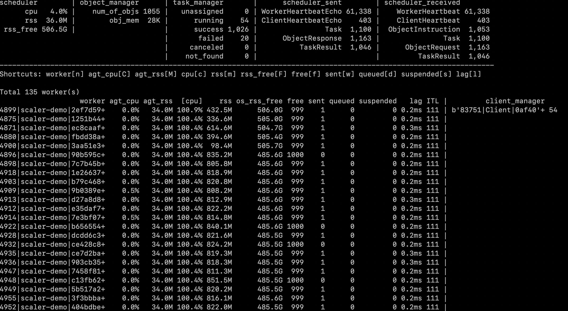
Scaler – scaler_top

Slide 17
Scaler – Failure recovery
Worker
$ scaler_cluster -n 8
Worker
Reroute
Scheduler
☠️
Reroute
Worker

Slide 18
Scaler – Dynamic load balancing
Worker
$ scaler_cluster -n 8
Worker
Reroute
Unassign
Scheduler
🥵
Reroute
Worker

Slide 19
Scaler – Nested and recursive tasks
def fibonacci(client: Client, n: int):
if n == 0:
return 0
elif n == 1:
return 1
else:
a = client.submit(fibonacci, client, n - 1)
b = client.submit(fibonacci, client, n - 2)
return a.result() + b.result()

Slide 20
Scaler – Worker tags
Soon
Worker 1
-tags macos,gpu
Worker 2
-tags linux,gpu
Worker 3
-tags linux
# Routed to worker 1 or worker 2
>>> client.submit(gpu_task, _tags={"gpu"})
# Routed to worker 2 only
>>> client.submit(linux_with_gpu_task, _tags={"linux", "gpu"})

Slide 21
Parfun
Parfun
A hassle-free map-reduce decorator

Slide 22
Parfun – Count words in text
from collections import Counter
def count_words(lines: List[str]) -> Counter:
counter = Counter()
for line in lines:
for word in line.split():
counter[word] += 1
return counter
>>> count_words(open("small_text.txt").readlines())
Counter({'the': 117,
'and': 106,
'of': 90,
'to': 83,
'in': 42,
'right': 33,
...})

Slide 23
Parfun – Map reduce
Process
Input
Split
Process
Combine
Output
Process

Slide 24
Parfun – @parfun
from parfun import parfun
from parfun.partition.api import per_argument
from parfun.partition.collection import list_by_chunk
@parfun(
split=per_argument(
lines=list_by_chunk
),
combine_with=sum,
)
def count_words(lines: List[str]) -> Counter:
...
>>> count_words(open("very_large_file.txt").readlines())
Counter({'the': 11700,
...

Slide 25
Parfun – @parfun
from parfun import parfun
from parfun.partition.api import per_argument
from parfun.partition.collection import list_by_chunk
@parfun(
split=per_argument(
lines=list_by_chunk
),
combine_with=sum,
)
def count_words(lines: List[str]) -> Counter:
...
>>> count_words(open("very_large_file.txt").readlines())
Counter({'the': 11700,
...

Slide 26
Parfun – Find the optimal batch size
How to find the optimal task batch size?
Too small: overheads will large
  Communication, IPC, synchronization ...
Too large: parallelism will be low

Slide 27
Parfun – Find the optimal batch size
Use Machine-Learning!
count_words()
total CPU execution time: 0:00:00.174216.
compute time: 0:00:00.165855 (95.20%)
min.: 0:00:00.017239
max.: 0:00:00.020540
avg.: 0:00:00.018428
total parallel overhead: 0:00:00.008361 (4.80%)
total partitioning: 0:00:00.006238 (3.58%)
average partitioning: 0:00:00.000693
total combining: 0:00:00.002123 (1.22%)
maximum speedup (theoretical): 8.48x
total partition count: 9
estimator state: running
estimated partition size: 1638

Slide 28
Pargraph
Pargraph
A declarative distributed graph engine

Slide 29
Pargraph – Declarative graphs
def generate_and_send_report(data_file_path: str, user_table: str) -> bool:
data = read_data_file(data_file_path)
processed_data = process_data(data)
report = create_report(processed_data)
users = read_postgres_table(user_table)
email_list = extract_emails(users)
success = send_report(report, email_list)
return success

Slide 30
Pargraph – Declarative graphs
def generate_and_send_report(data_file_path: str, user_table: str) -> bool:
data = read_data_file(data_file_path)
processed_data = process_data(data)
report = create_report(processed_data)
users = read_postgres_table(user_table)
email_list = extract_emails(users)
success = send_report(report, email_list)
return success
Can run concurrently !

Slide 31
Pargraph – Declarative graphs
from pargraph import delayed, graph
@delayed
def read_data_file(file_path: str) -> str:
...
@delayed
def read_postgres_table(table: str) -> List[Tuple]:
...
@delayed
def extract_emails(table_content: List[Tuple]) -> List[str]:
...
...
@graph
def generate_and_send_report(data_file_path: str, user_table: str) -> bool:
...

Slide 32
Pargraph – Declarative graphs
from pargraph import delayed, graph
@delayed
def read_data_file(file_path: str) -> str:
...
@delayed
def read_postgres_table(table: str) -> List[Tuple]:
...
@delayed
def extract_emails(table_content: List[Tuple]) -> List[str]:
...
...
@graph
def generate_and_send_report(data_file_path: str, user_table: str) -> bool:
...
Leaf nodes

Slide 33
Pargraph – Declarative graphs
>>> generate_and_send_report.to_graph()
with Client(scheduler_url) as client:
client.get(generate_and_send_report.to_graph(data_file_path=..., ...))

Slide 34
Pargraph – Declarative graphs
>>> generate_and_send_report.to_graph()
with Client(scheduler_url) as client:
client.get(generate_and_send_report.to_graph(data_file_path=..., ...))

Slide 35
Thank you !
Q & A
Raphael J.
https://raphaelj.be

